Slide 1

Power Factor Improvement Automatic Device || Decrease Electricity Cost By Improving Power Factor.
Presented By -
Mohammad Mostofa Ashik
ID - 20200105229
Emtiaz Uddin
ID - 20200105231
Tahnia Oqba
ID - 20200105232
Mahir Foysal
ID - 20200105233
Saji Pal
ID - 20200105235
G.M Hrid Ahalan Habib
ID - 170105032

Slide 2
INTRODUCTION
The electricity is generated and transmitted intensively in the form alternating current; the term power factor comes into play in alternating current transmission, in real time transmission most of the electrical loads are inductive in nature so they create low lagging power factor on the source this undesirable lagging power factor results in increasing current and increasing the loss of active power in the electrical system, high copper loss, poor voltage regulation, right from source to load, so we need to improve the power factor, our project objective is to provide a better situations in energy transmission providing favorable economical conditions and power cost management.

Slide 3
The major cause of poor power factor is due the inductive load behavior so we need to connect an extra device which takes leading power hence the capacitor is connected in parallel to the device to balance the power factor, in this project the power factor improvement plant consists of a Capacitor, Relay, Magnetic contactor, Fuse, Bus-bar, KVA meter, Ampere Selector, Voltage Selector. The assembly and their working phenomenon were clearly explained in the working section.
This power factor improvement plants uses the capacitors as a major source to improve power factor. This is related to the conventional static capacitor phenomenon but it is different because it uses relays and measuring meters to sense the variations in power factor and acts accordingly based on the requirement automatically. This automatic operation is facilitated by the electromagnetic relay which operates when the power factor is low.

Slide 4
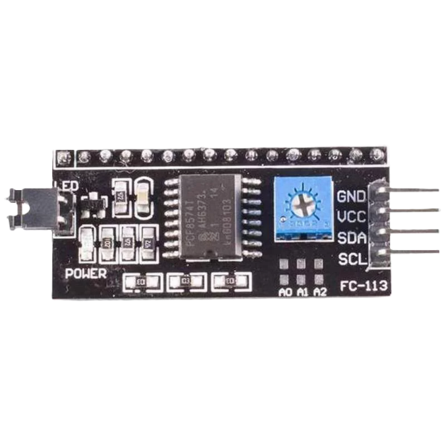
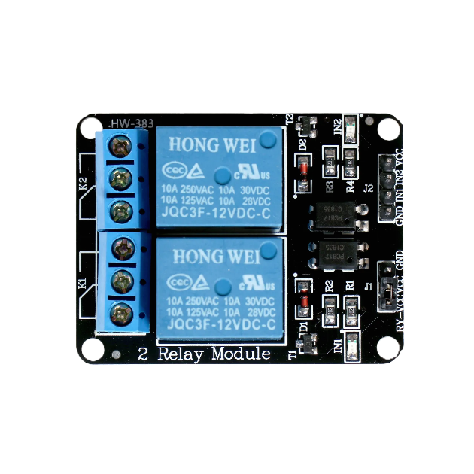
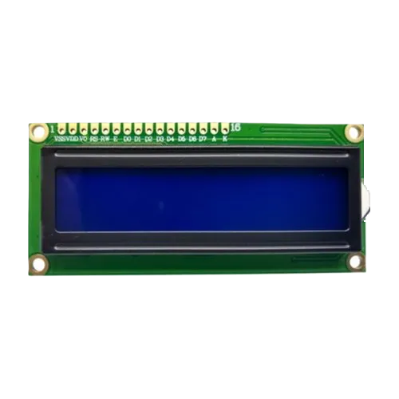
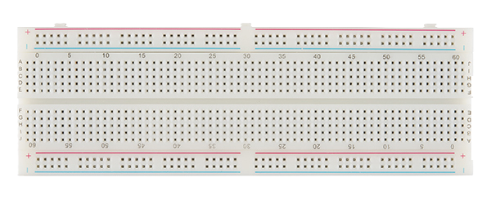
APPARATUS
1. 5V 2 Channel Relay Module
2. I2C MODULE
3. 16x2 LCD Module
4. Breadboard

Slide 5
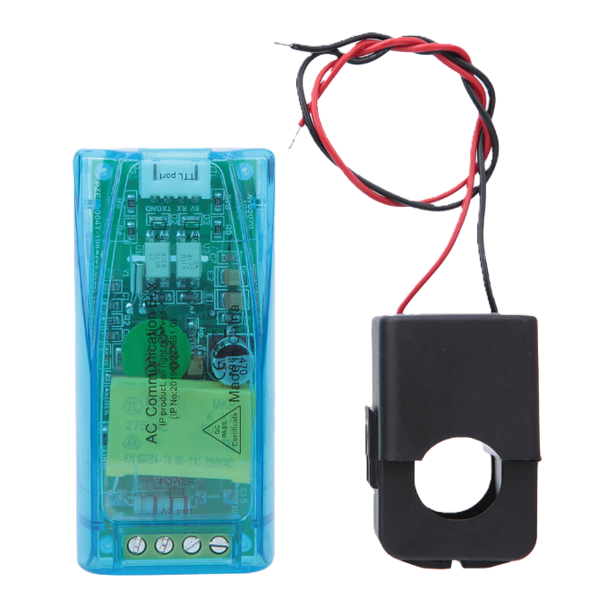
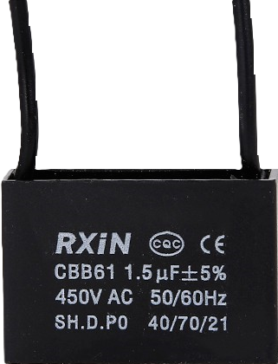
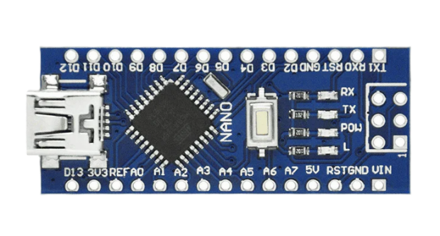
APPARATUS
5. PZEM-004T V3.0 AC Digital Multifunction Meter Watt Power Volt Amp With Coil 100A
6. Arduino Nano
7. 1.5uF 450V Capacitor

Slide 6
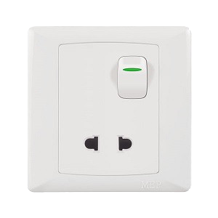
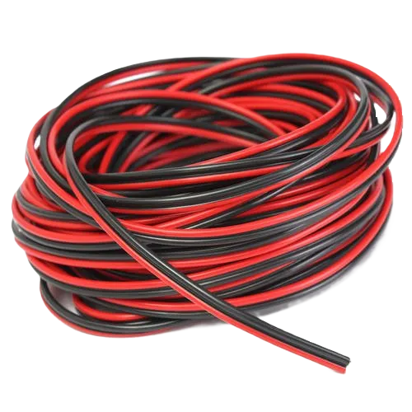
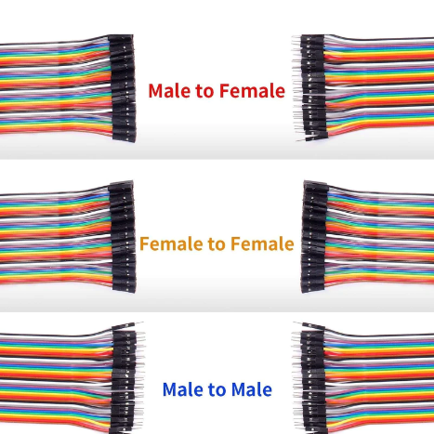
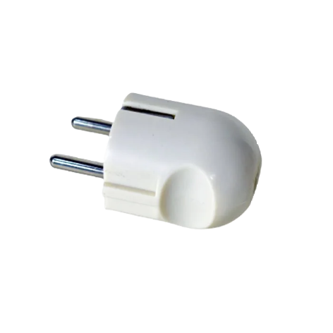
APPARATUS
8. Socket
9. 2 pin Plug
10. Electric Wire
11. Jumper Wire

Slide 7
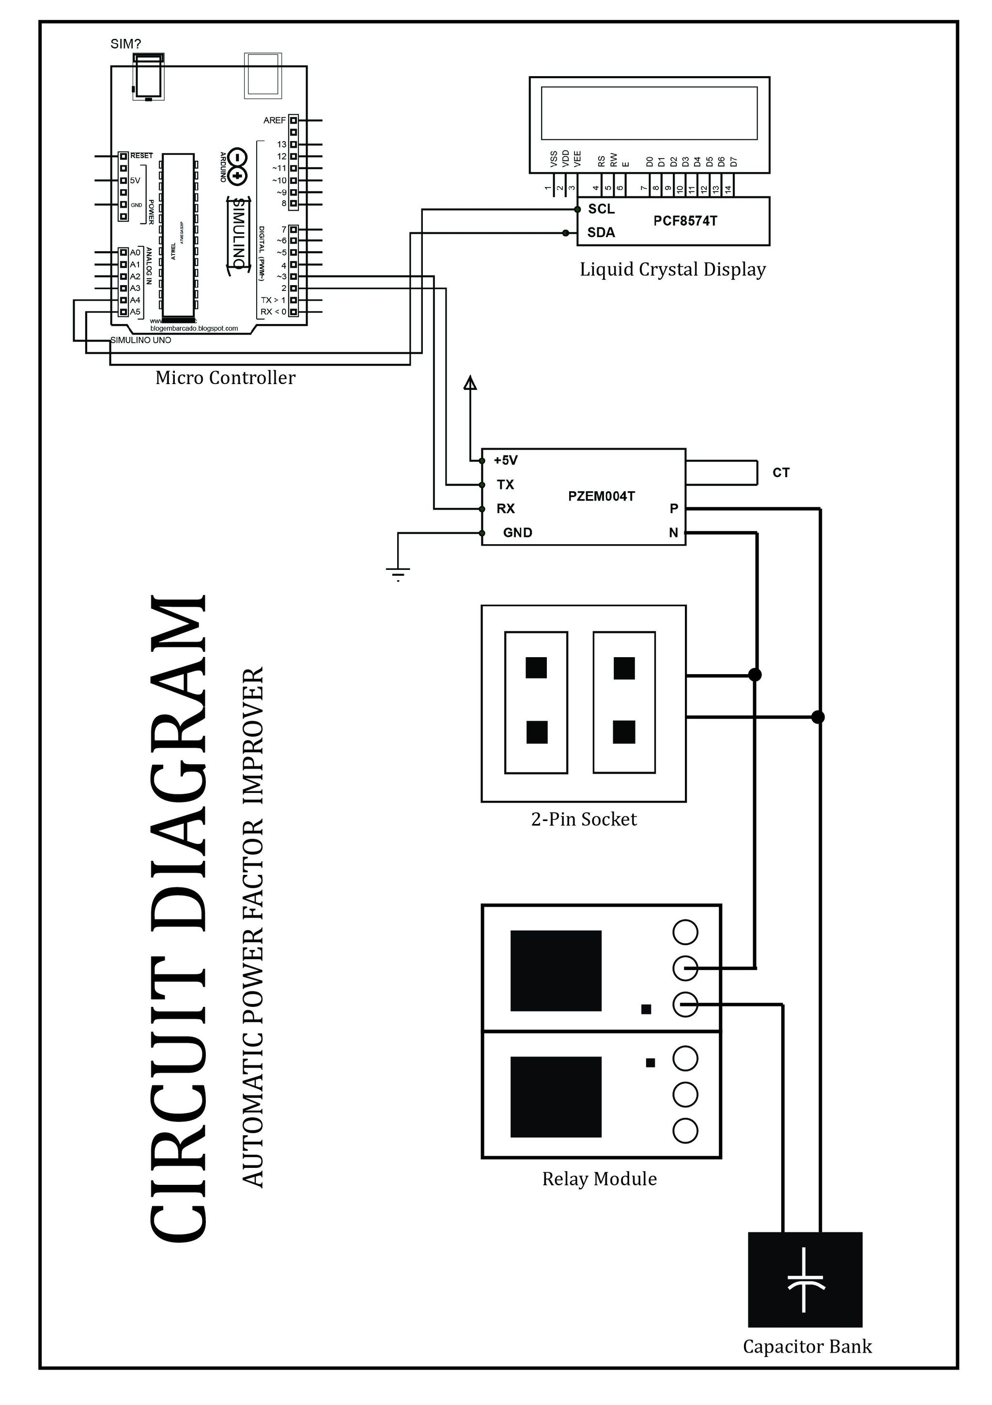
CIRCUITDIAGRAM

Slide 8
WORK FLOW
AC supply
PF Indication ON
Relay Module OFF
Load Connected
Capacitor Connected
Relay Module ON
PZEM Power Sensor Module ON
Arduino ON

Slide 9
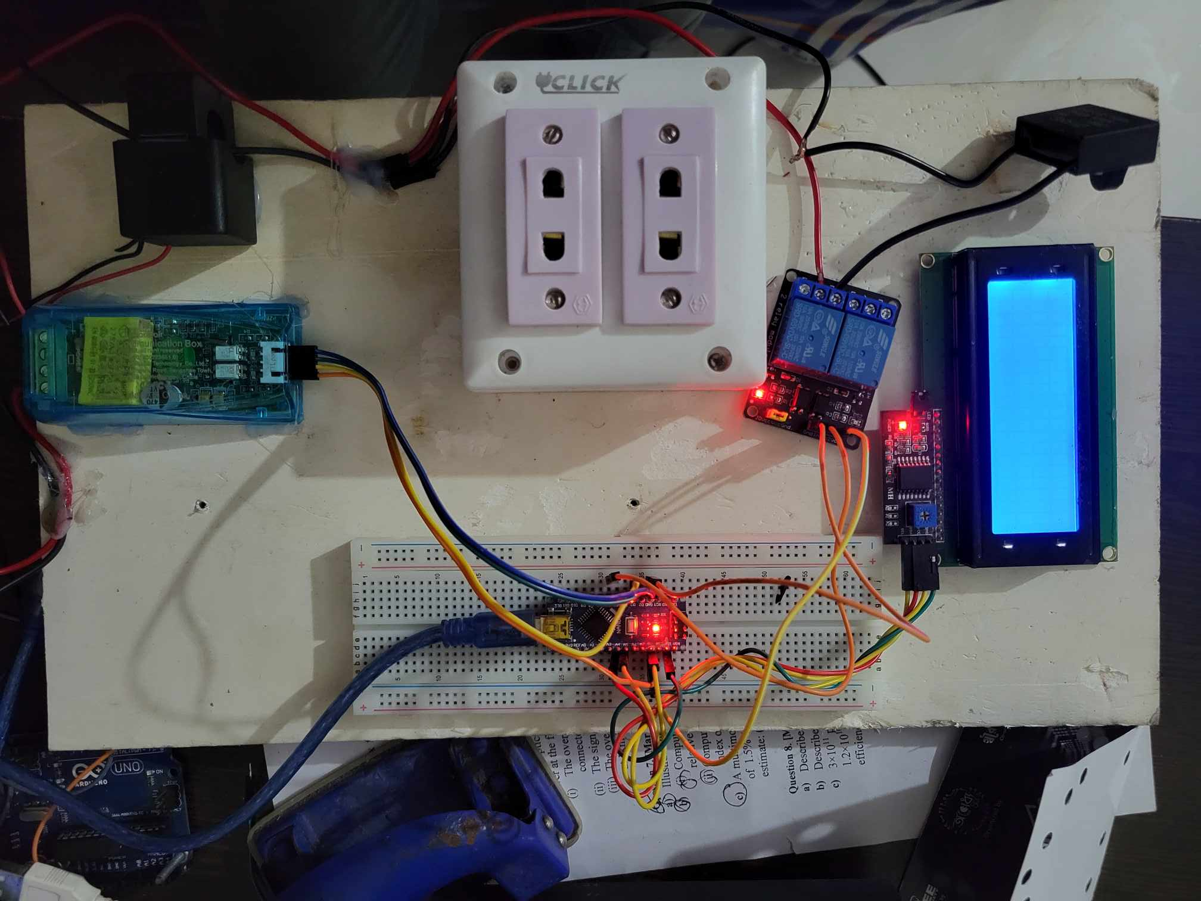
PRACTICAL PICTURE

Slide 10
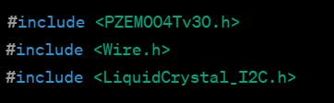

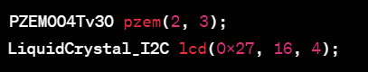
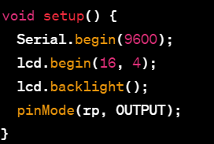
CODE:
Include Libraries
Define Constants
Create Objects
Step Function

Slide 11
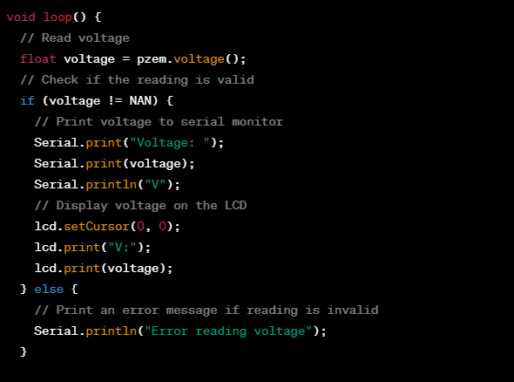
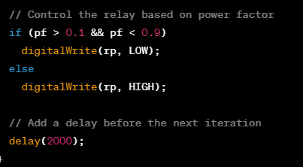
CODE:
Loop Function
Control Relay Module

Slide 12
#include <PZEM004Tv30.h>
#include <Wire.h>
#include <LiquidCrystal_I2C.h>
#define rp 6
PZEM004Tv30 pzem(2, 3);
LiquidCrystal_I2C lcd(0x27, 16, 4);
void setup() {
Serial.begin(9600);
lcd.begin(16,4);
lcd.backlight();
pinMode(rp,OUTPUT);
}
void loop() {
float voltage = pzem.voltage();
if (voltage != NAN) {
Serial.print("Voltage: ");
Serial.print(voltage);
Serial.println("V");
lcd.setCursor(0, 0);
lcd.print("V:");
lcd.print(voltage);
} else {
Serial.println("Error reading voltage");
}
float current = pzem.current();
if (current != NAN) {
Serial.print("Current: ");
Serial.print(current);
Serial.println("A");
lcd.setCursor(0, 1);
lcd.print("I:");
lcd.print(current);
} else {
Serial.println("Error reading current");
float power = pzem.power();
if (current != NAN) {
Serial.print("Power: ");
Serial.println("W");
lcd.setCursor(8, 0);
lcd.print("W:");
lcd.print(power);
} else {
Serial.println("Error reading power");
}
float frequency = pzem.frequency();
if (current != NAN) {
Serial.print("Frequency: ");
Serial.print(frequency, 1);
Serial.println("Hz");
lcd.setCursor(0, 2);
lcd.print("Freq:");
lcd.print(frequency);
} else {
Serial.println("Error reading frequency");
}
float pf = pzem.pf();
if (current != NAN) {
Serial.print("PF: ");
Serial.println(pf);
lcd.setCursor(8, 1);
lcd.print("PF:");
lcd.print(pf);
} else {
Serial.println("Error reading power factor");
}
if(pf>0.1 && pf<0.9)
digitalWrite(rp,LOW);
else
digitalWrite(rp,HIGH);
Serial.println();
delay(2000);
}

Slide 13
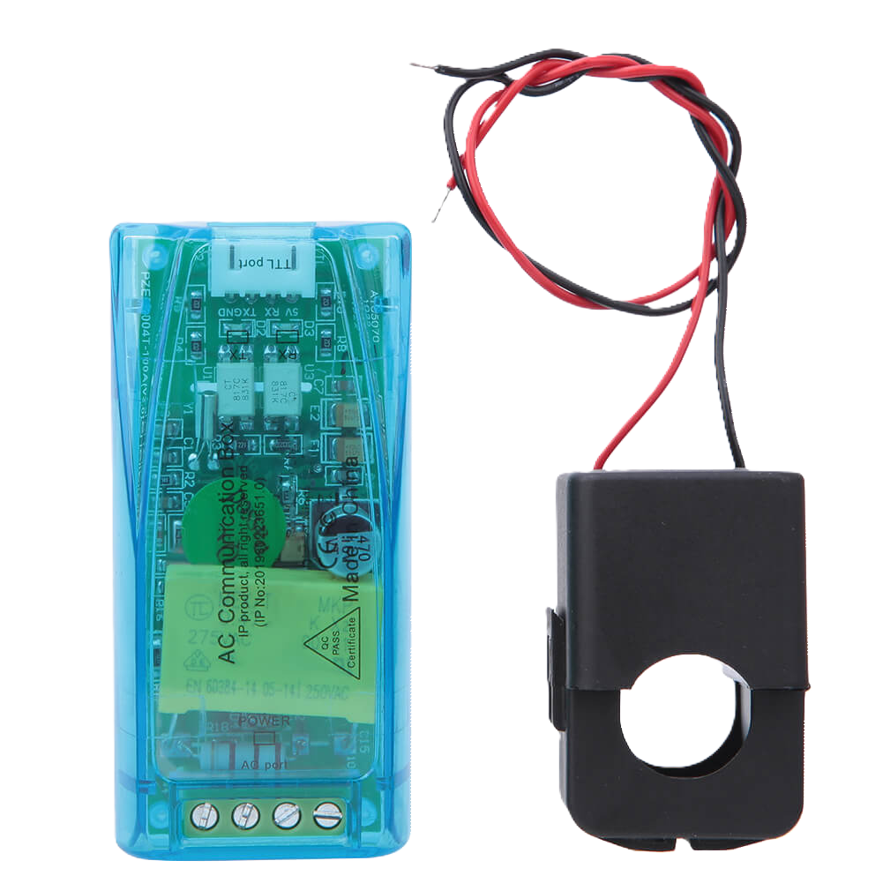
WORKING PROCESS
PZEM-004T V3.0 AC Digital Multifunction Meter Watt Power Volt Amp With Coil 100A
The PZEM-004T V3.0 AC Digital Multifunction Meter with Coil (100A) is a versatile device used for measuring various electrical parameters in an AC power system. It can measure voltage, current, power, energy consumption, frequency, and power factor. The meter comes equipped with a current transformer for measuring current up to 100A. Additionally, it may include features such as overload protection and a communication interface (e.g., RS485) for data logging or monitoring applications. This multifunction meter is commonly employed in energy monitoring systems, power quality analysis, and DIY projects requiring accurate electrical measurements.

Slide 14
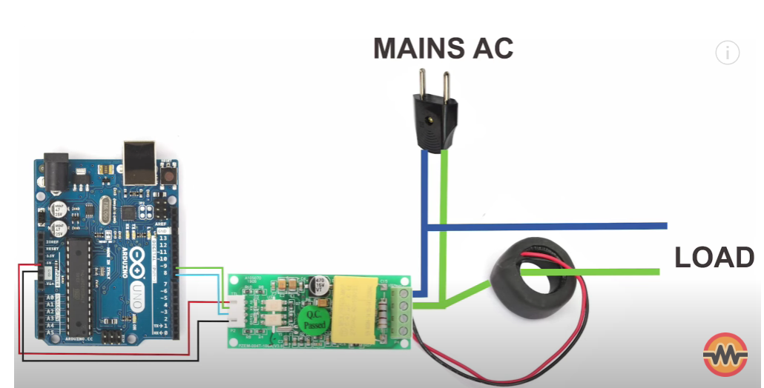

Slide 15
Working of PZEM-004T Sensor
We are using a 100A CT of split core model which measure current according to Faradays law of electromagnetic induction.
Voltage divider circuit place inside the sensor measure the voltage.
TTL serial communication protocol used to transmit data to external devices.
Main part of the module is SD3004 chip and two opto-coupler PC817 are used providing galvanic isolation of the serial interface

Slide 16
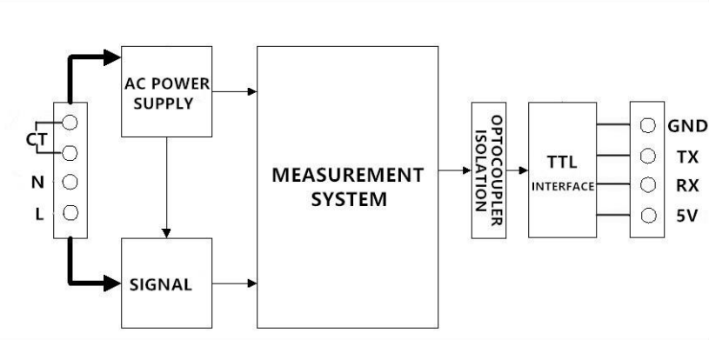
Functional Block Diagram of PZEM-004T100A

Slide 17








APPLICATION
Industrial Machinery and Equipment
Electric Vehicle Charging Stations
.
Commercial Establishments
01
08
02
Telecommunication Infrastructure
Power Factor Improvement Automatic Device
Residential Applications
07
POWERPOINT TEMPLATE
03
06
04
05
Data Centers
Renewable Energy Systems
Agricultural Operations

